Slide 1
ELEMENTS OF MISE-EN-SCENE

Slide 2
Mise En Scene
Everything that appears before the camera and its arrangement—composition, sets, props, actors, costumes, and lighting. It helps express a film’s vision by generating a sense of time and space, as well as setting a mood, and sometimes suggesting a character’s state of mind.

Slide 3
Composition
The placement or arrangement of visual elements or ingredients in a work of art, as distinct from the subject of a work.
Composition in Storytelling
Quadrant

Slide 4
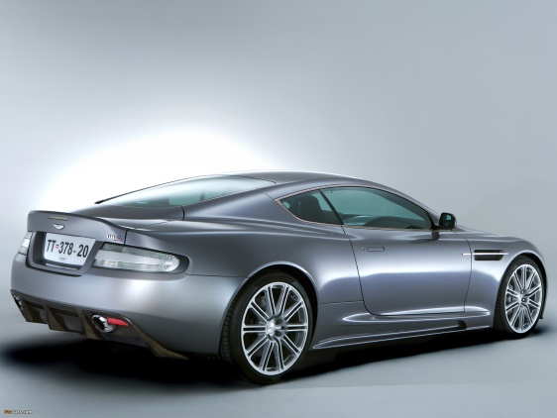
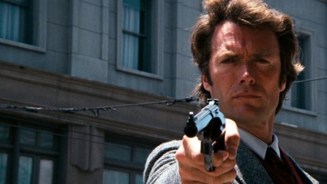
INSTRUMENTAL PROPS
Displayed and used according to their common function.

Slide 5
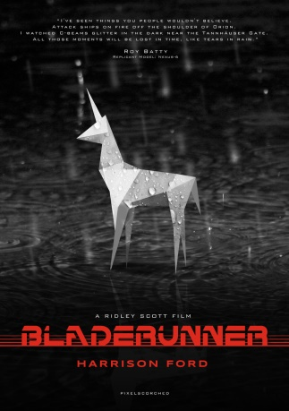
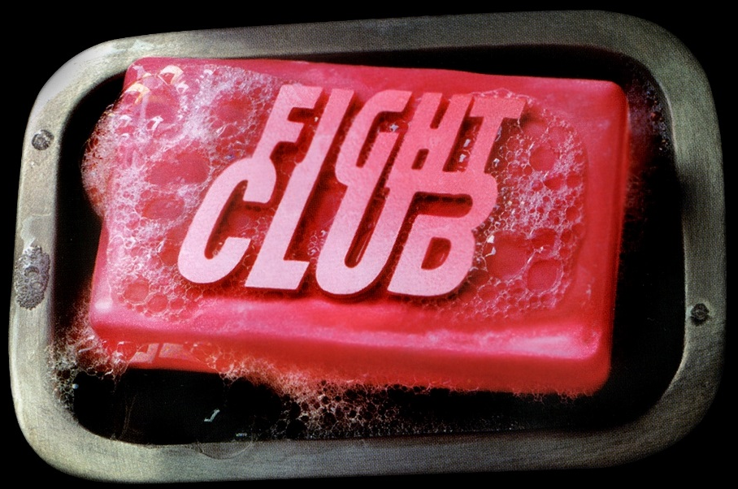
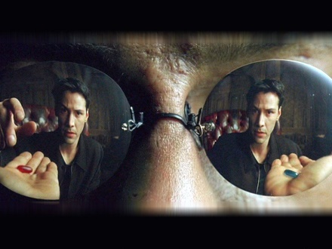
METAPHORICAL PROPS
Same objects reinvented or employed for an unexpected or magical purpose, or invested with metaphorical meaning.

Slide 6
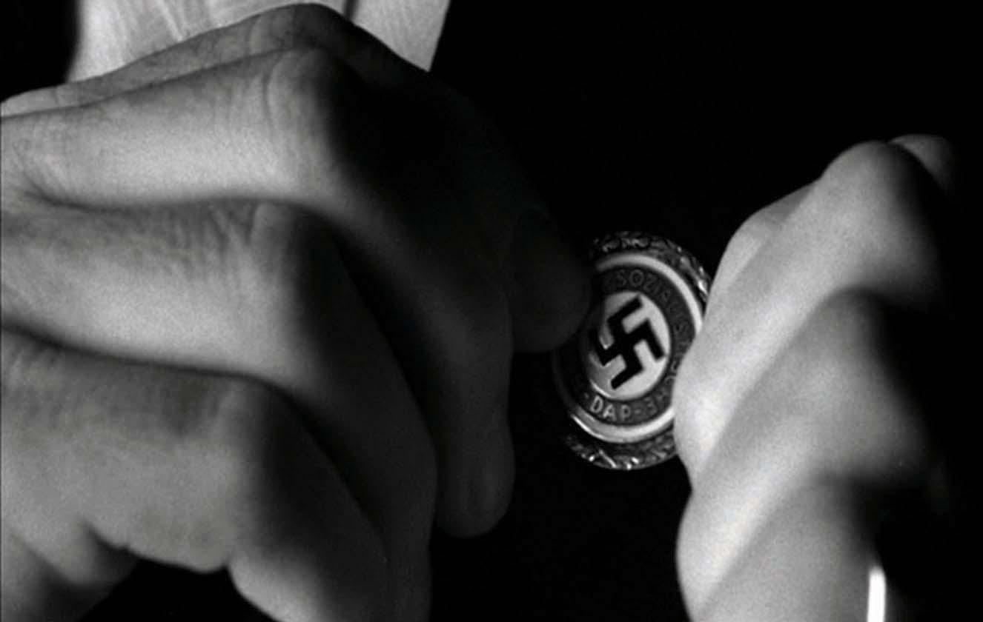
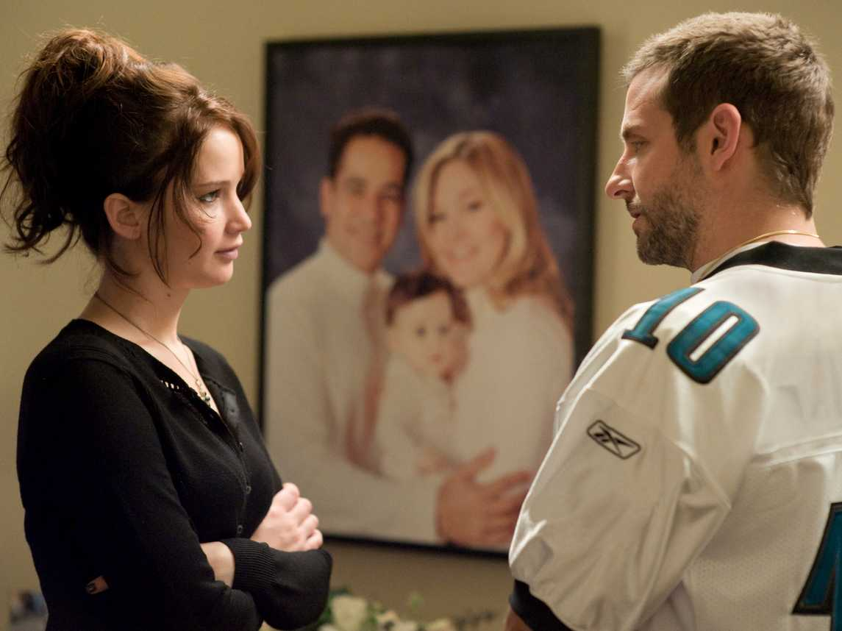
Cultural Props
Carry meanings associated with their place in a particular society.

Slide 7
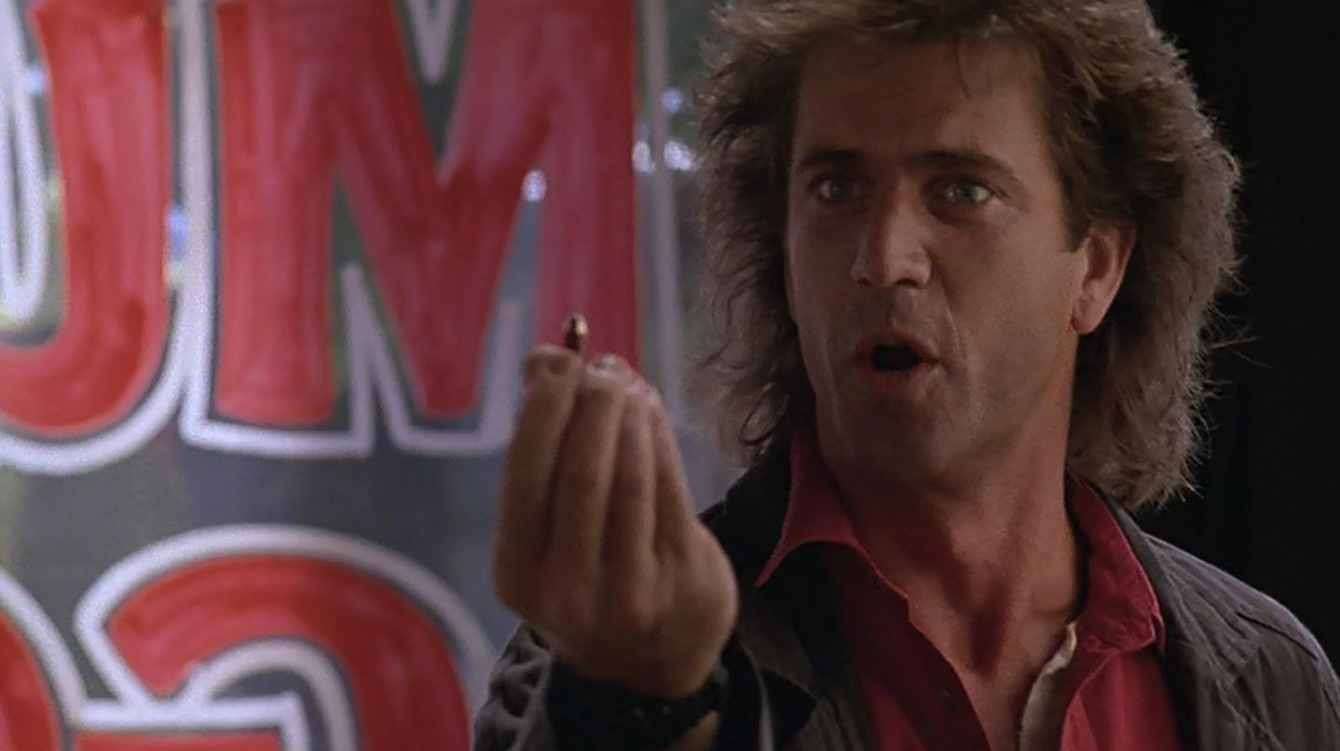
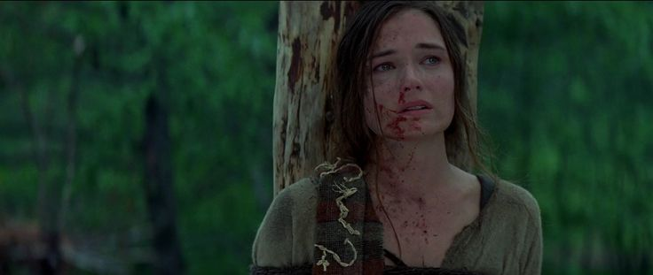
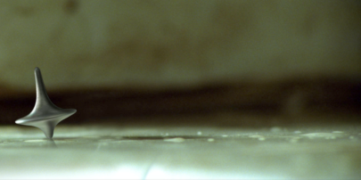
Contextualized Props
Acquire meaning through their changing place in a narrative

Slide 8
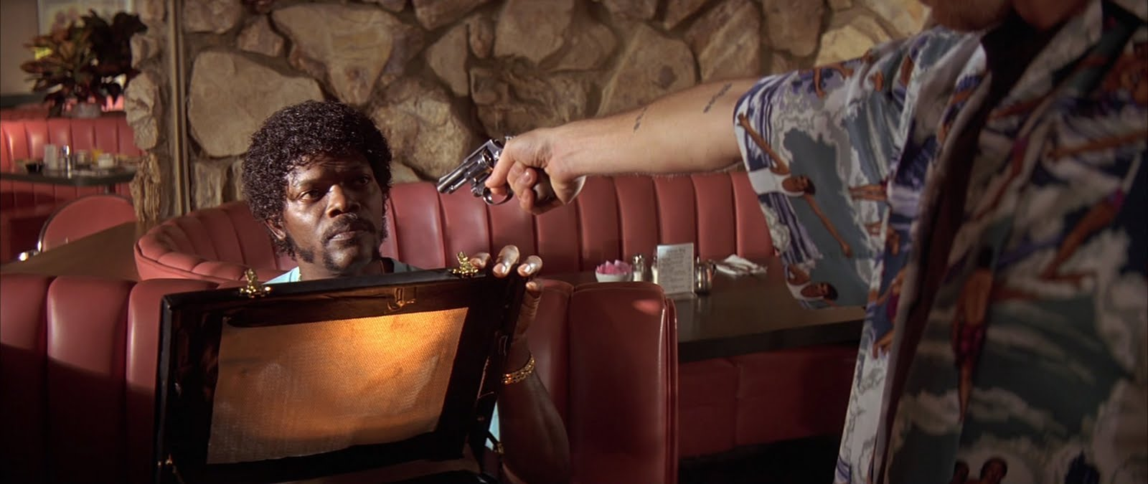
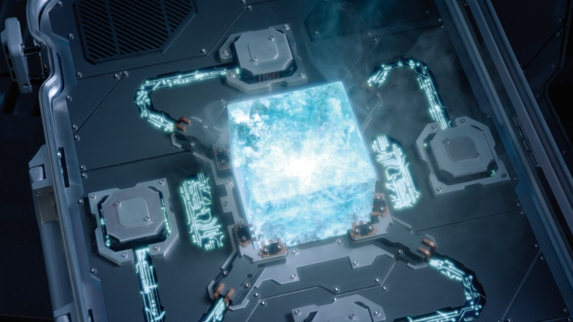
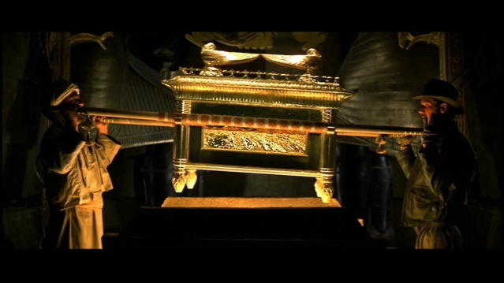
McGuffins
Props that appear to be important, but only have significance in that they move the plot forward.

Slide 9
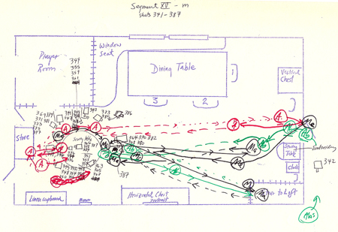
BLOCKING
The arrangement and movement of actors in relation to each other within the single physical space of a mise-en-scene. Hitchcock Blocking

Slide 10
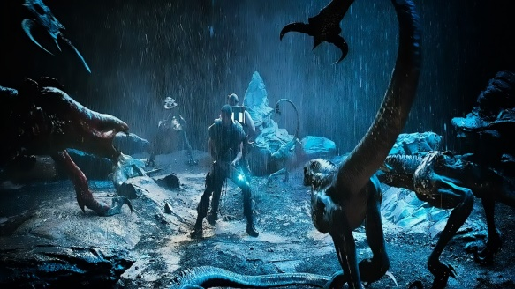
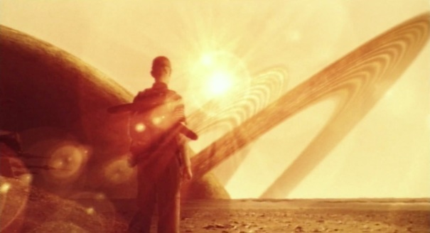
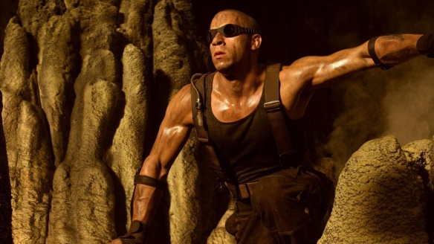
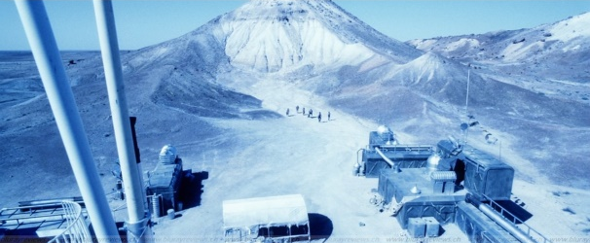
LIGHTING
Light sources located within the scene.

Slide 11
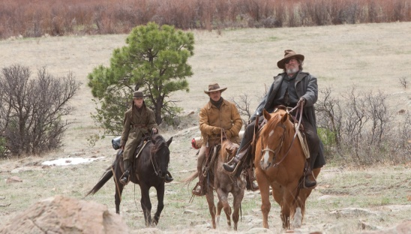
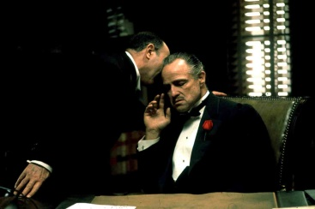
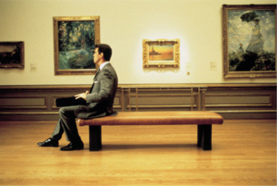
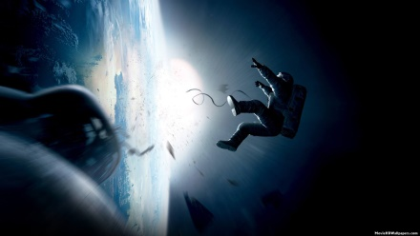
Scenic atmosphere and connotations
Scenic Atmosphere and Connotations- Those feelings or meanings associated with particular sets or settings in a film. (i.e. ship on open ocean suggest danger and adventure, a kitchen set connote comfortable, domestic feelings.

Slide 12
Realism
The extent that a movie creates a truthful picture of a society, person, or some other dimension of life. It can refer to psychological or emotional accuracy (in characters), recognizable or logical actions and developments (in a story), or convincing views and perspectives of those characters or events (in the composition of the image).

